Slide 1
Dell Women’s Entrepreneur Network Maximize Your Membership with DWEN

Slide 2
At DWEN, We Believe in Entrepreneurs
Starting or scaling is a critical time for any business and DWEN empowers entrepreneurs through innovation and technology while supporting the entrepreneurial ecosystem.

Slide 3
Why is Dell supporting Women Entrepreneurs? DWEN’s mission as a community is to advance women- owned business through community, technology and funding resources. Investing in women positively impacts the global economy. Women-owned businesses are significant drivers of job creation and economic growth. Striving to support women who have historically been under-served.

Slide 4
DWEN connects female entrepreneurs around the globe with networks, knowledge and insight that gives them power to do more
CONNECT
INSPIRE
TRANSFORM
Access a growing community of women entrepreneurs, investors and advisors both in-person and online.
Mentor Program
Events
Dell Tech Advisor
Workshops
Share your stories, learn from others. Take advantage of opportunities to be spotlighted on a global platform
Blogs
Women on the Rise
Member Voices
DreamTech
Tailored content and technology resources to accelerate your business and help it reach its maximum potential.
DWEN Tech Hub
DWEN Funding Hub
WE Cities Index Research
Empower Hours & Tech Talks

Slide 5
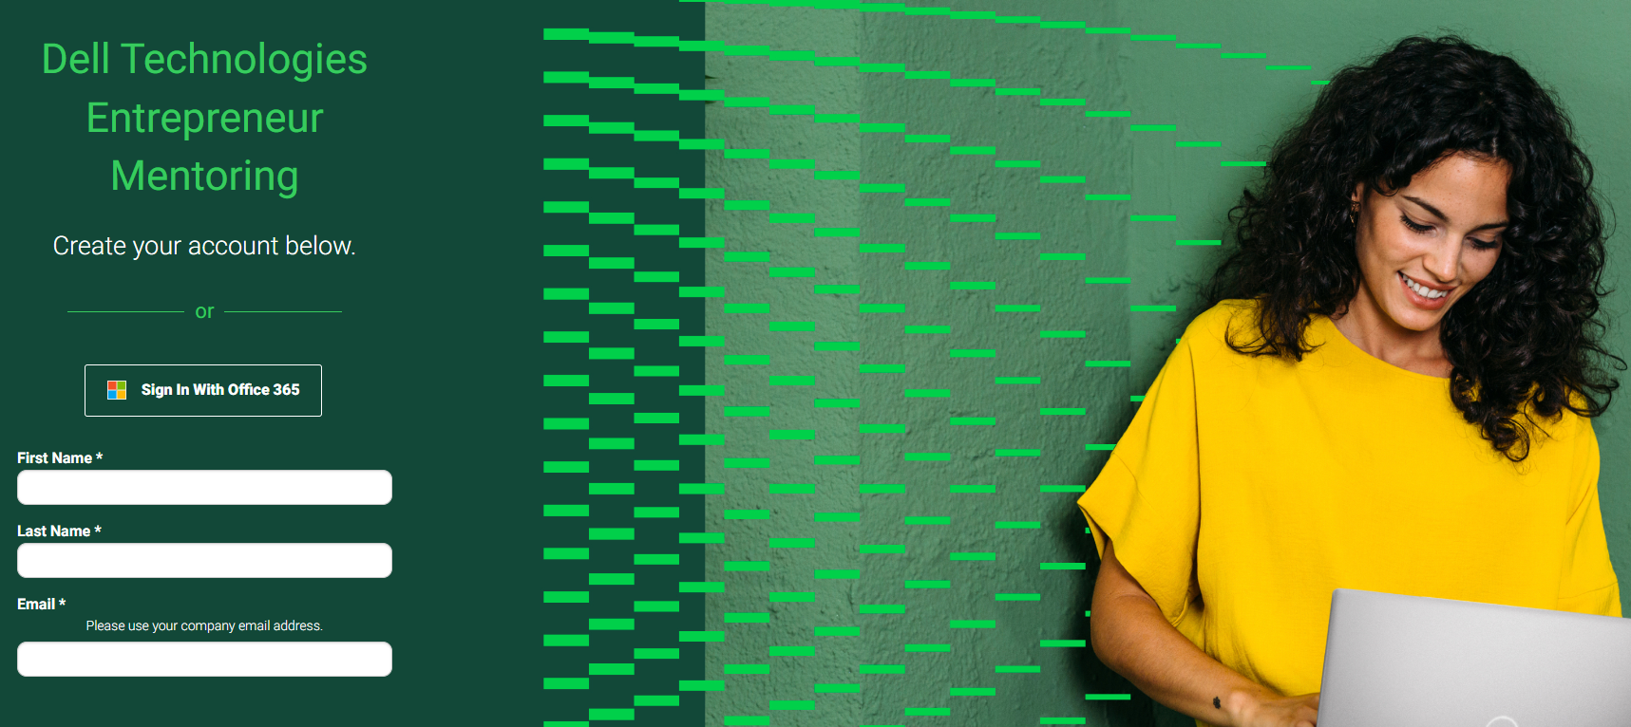
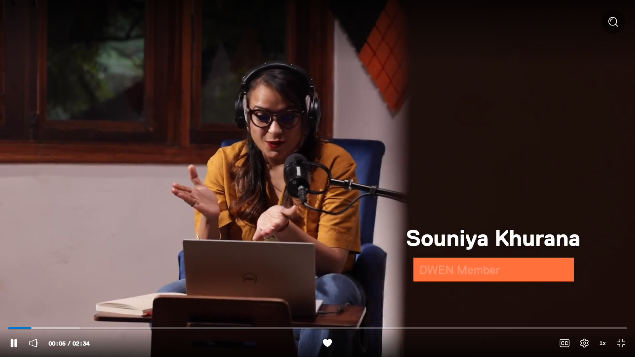
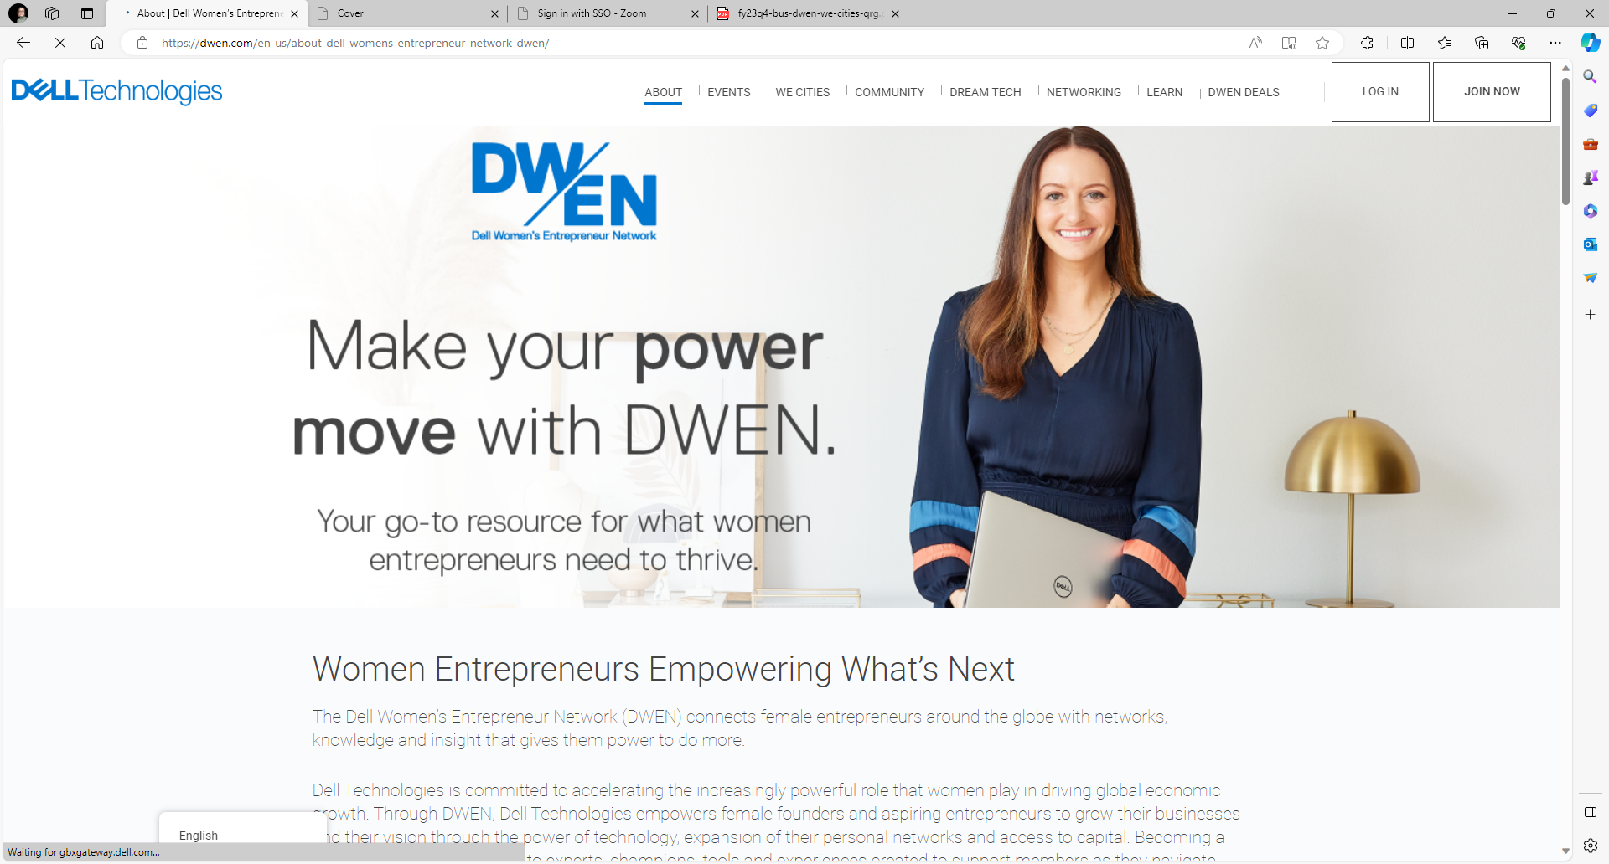
Looking Back, Looking Forward
2023:
Relaunch of WECities + Experiential
Dream Tech Contest cont.
Fast Company partnerships
Mentoring Pilot
2024
Mentor Program
Tech Round Up
Roadshow events to support DWEN awareness and growth
2009:
Launch of DWEN
2016: Launch of WeCities Index Research
2019: 10 year anniversary at the global summit in Singapore
2020:
Launch of online community
1st Virtual Summit
Content building with media partners
2021:
Launch of Dream Tech Contest
Content development with TED
2022:
2nd virtual Summit
Dream Tech Cont.
Businesses We love
2009 - 2019
2020
2021
2022
2023
2024
Launch!
Launch!
Launch!

Slide 6
+109K Members globally
Benefits:
Learning Resources
Webinars + Events
In-Person Events
Mentoring Program
Dedicated Dell Tech Advisor
DWEN Rewards
The Dell Women’s Entrepreneur Network (DWEN) connects female entrepreneurs around the globe with networks, knowledge and insight that gives them power to do more.
DWEN.com

Slide 7
DWEN Community
Tell Us About You
DWEN leverages your member profile to understand the needs of our members and share relevant benefits.
Keep your profile up-to-date to ensure content is tailored to meet your needs.
Respond to member surveys and polls throughout the year to share your input.
Aspiring Entrepreneurs
Women who are in the process of building or pursuing their own business, product or service, or exploring the world of entrepreneurialism.
Women Founders
Women Business Owners, Co-Owners, Founders, or Co-founders wishing to use the DWEN community to advance their business, product or service.
DWEN Champions
Investors, Partners, or Dell Technologies team members who are currently, or desire to support women entrepreneurs through the DWEN community
Notes:
Our DWEN community is made up of all types of entrepreneurs.
We welcome
Aspiring Entrepreneurs - Women who are in the process of building or pursuing their own business, product or service, or exploring the world of entrepreneurialism.
Women Founders - Women Business Owners, Co-Owners, Founders, or Co-founders wishing to use the DWEN community to advance their business, product or service.
And DWEN Champions - Investors, Partners, or Dell Technologies team members who are currently, or desire to support women entrepreneurs through the DWEN community
And we welcome all industries – not just women who work in technology.
Any woman entrepreneur across all sectors and stages is welcome to join the community.
As you get settled into your new membership…. We want to know where you are in your entrepreneurial journey. Knowing this information will help us tailor our programming to your needs.
You can help us know this by updating your member profile on DWEN.com.
Or as you see surveys from us… or share feedback following events and webinars….please let us know who you are and how we are doing.

Slide 8
Meet Your Network
109,000+
Fellow DWEN members across the globe sharing and growing together
Of DWEN members are a Business Owner, Founder or Partner
91%
88%
Work at small businesses with fewer than 10 employees
9
The average age of DWEN members’ businesses
69
Work at businesses for which the owner managers their IT needs.
49
The average age of DWEN members.

Slide 9
Your Voice Shapes DWEN
"The community that exists within DWEN that exists within Dell, it’s probably fairly minor, but they just won company of the year for world changing ideas. And that to me just goes to show that we are all in the right place. It’s not just about technology and software. It’s about people.“– DWEN Member
"One thing everyone can’t forget is the value and the power of communities around you that are in similar shoes as yourself. And I wish I had had a DWEN in my life when I started Hedley and Bennett and I didn’t. And now I feel so fortunate to be a part of it."
- Ellen Bennett, founder and Chief Brand Officer of Hedley & Bennett
“I love the educational aspects of DWEN and learning from other experts and entrepreneurs about best practices for growing my business.” – Annual Survey
"The network of DWEN will give you the opportunity not only to receive help and mentorship, but then to pay it forward. These are the types of things that are actually world changing. Thes are the types of things that change business for women especially and change business on a global level."
– Dream Tech Winner Kristian Rene
"The caliber of person who chooses to help themselves and utilize services like the Dell Entrepreneur Mentoring Program is already on a path to success. They are clear on what they need and who they are, they just need support in where they are going. The program is incredible. It brings people together from all walks of life and shows us the common threads that facilitate our ability to help each other. The Dell Entrepreneur Mentoring Program is one of the most important opportunities of my professional life, right now.“ – Mentor from Mentor Program (also a DWEN member)
"As a woman in business having the correct information and knowing of the available resources Dell always DELIVERS. “ - Webinar Attendee
"This is THE best mentoring experience I have had to date! My mentor is an incredible listener who is helping me strategize the best next steps I should take, which is something I have needed. I am truly grateful for having access to my mentor and super glad I signed up to be a part of DWEN when I did!” – Mentee from Mentor Program

Slide 10
DWEN Benefits Professional Development and Networking

Slide 11
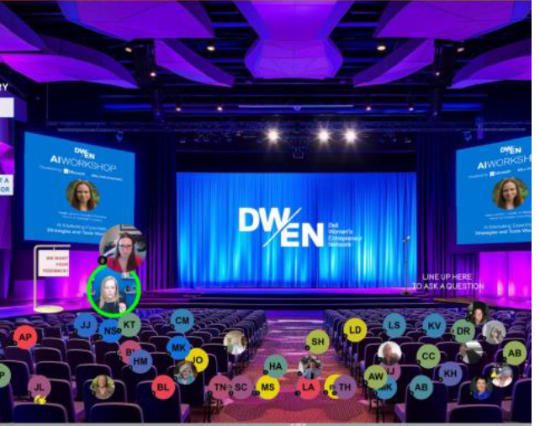
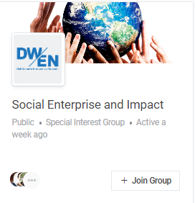
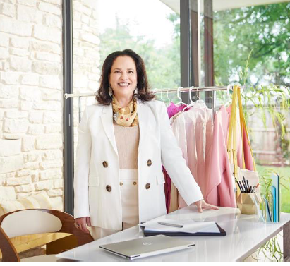
Connect
DWEN connects like-minded female founders around the globe who are motivated to drive change and progress within their respective industries. You are an important part of that network. Start building your connections today.
Workshops
In Person Events
Mentor Program
Dell Tech Advisor
Participate in interactive virtual and dynamic in person Workshops to connect with thought leaders on topics like AI and Innovation.
Participate in roadshow events and networking opportunities hosted by Special Interest Groups (SIGs) or one of our 45+ Chapters to engage and learn together.
The Mentor Program connects you with an experienced professional to provide advice and guidance on your entrepreneurial journey of launching and
growing your business
Gain access to a Dell Tech Advisor who can help review your IT equipment, your business needs, and advise you on the next steps when making short and long-term technology decisions.

Slide 12
Dell Technologies Entrepreneur Mentoring Advice to get Growing
What
Why
Entrepreneur mentoring is a supportive relationship where an experienced professional provides advice and guidance to you throughout your journey of launching and
growing your business
92% of small business owners agree mentors have a direct impact on the growth and survival of their business.*
20% of new businesses fail within the first two years and 45% within 5th year
Entrepreneurs who receive mentoring are 2x likely to survive compared to those who do not.***
80% of mentored businesses have witnessed long term success, growth, and business revenues. ****
You can schedule 30-minute one-on-one mentoring sessions with mentors from Dell Technologies, strategic partners and seasoned entrepreneurs who can advise on a variety of professional areas and conversation topics that are crucial for growth.

Slide 13
Mentor Program

Slide 14
Inspire
Become a better leader for your business, team, and customers. Explore inspiring founder stories, actionable tips, and creative solutions to help drive your business.
Blogs
Member Voices
DWEN Rewards
New Dream Tech
Woman on the Rise
Member Voices webcasts offer a way to learn through the power of community. Using storytelling, personal experience and knowledge sharing it fuels new ideas, solutions, and inspiration you to drive your business.
Take a spin on the DWEN spinner to redeem DWEN rewards such as prizes, discounts, training courses and perks for your business
Share your unique story and win as a part of the global Dream Tech and Entrepreneur Challenge that has awarded over $400K+ in recent contests.
Woman on the Rise highlights members and the impact they make in their communities. Read about their entrepreneurial journeys and best advice for navigating the entrepreneurial life.
Unleash your professional mindset and learn from other DWEN members through DWEN’s blogs series.

Slide 15
Member Voices
Spotlighting expertise, experiences, hard-earned problem-solving techniques, and lessons learned from the community.
Presentations and articles are featured in the DWEN Blog, Media Hub, and hosted as live member webcasts.
YOU can share your knowledge! Member Voices welcomes a submission process throughout the year.
Applications will open again on September 9: https://dwen.com/en-us/member-voices/

Slide 16
Recent Webcasts – Available On Demand
Topic​ | Speaker​
Empower Hour LIVE: Business and Legal Considerations for Raising Capital | Clark Wilkes and Radhika Malik
Empower Hour LIVE: Creating a Pitch that Slays and Pays | Precious Williams
Empower Hour LIVE: Safeguard Your Business: Navigating Intellectual Property & Contracts | Tom Brown
Empower Hour: Breaking the Cycle of Self Doubt: Overcoming Imposter Syndrome | Alyssa Dver
Empower Hour: Choosing the Right Business Entity From a Legal and Tax Perspective | Marietta Courtney and Jordan Garside
Empower Hour: Crafting Your Personal and Professional Brand | Aliza Licht
Empower Hour: How to Be Your Most Confident Self | Holly Tucker
Empower Hour: How to Develop an Executive Mindset | Ilhiana Rojas Saldana
Empower Hour: How to Prioritize Your Health and Happiness | Zuriel Gibson
Empower Hour: Selling Into Big Companies: Tips and Tools to Break Into the Enterprise | Carole Mahoney, Paula Arevalo, Meredith Melecki
Empower Hour: Set and Get Your Bold Goals | Tracie Root
Empower Hour: Turning Inspiration Into Action | Ashley Miles
Tech Talk: A Founder's Journey: Finding Startup Success in Silicon Valley and Beyond | Shenea Leven and Michelle Gonzalez
Tech Talk: AI for Business: How to Leverage the Power of AI with Microsoft | Amy Hinchey
Tech Talk: Building Better: Using Sustainable Product Development to Improve Your Bottom Line | Michelle Chuaprasert, Jamila Cowan, Katie Green
TechTalk: Trends and Technology that Shape the Future of Work for Small Business | Yana Terukhova
TechTalk: Breaking Barriers - Lessons in Resiliant Leadership | Rola Daghar
TechTalk: Dream First, Details Later: LINKEDIN LIVE | Ellen Bennett
TechTalk: I’m a Dell Tech Advisor, Ask Me Anything: Make Your Tech Work for You | Oren Fisher
TechTalk: Managing and Enhancing Modern Work – Remote, Hybrid, Office and Everything In-Between | Sarah Wieskus
TechTalk: Navigating the Cloud for Business Success | Karen Fassio

Slide 17
Top Requested Webcast Topics
AI in Small Business
Balancing Work & Life
AI Tools and Products & Implementation
Legal Requirements, Building an LLC
How to Build a Team
How to Make Sales
Email, Digital and Social Marketing Strategies
Imposter Syndrome / Establishing Confidence
Creating Your Brand
Speaking and Communication Skills as a Leader
Managing Finances for Your Business
Funding Opportunities for Small Business Owners
Add to the chat what topics you would add to the list.

Slide 18
Transform
From expert funding advise, to technology tips, to lessons on success and failure, DWEN provides you with valuable and compelling resources. .
Funding Hub
On-Demand Video Library
Tech Hub
Articles
Live Webcasts
The Funding Hub, created in partnership with Global Invest Her, is designed and curated to help you along your funding journey
Watch content, including Empower Hours and Tech Talks, on your schedule by visiting the on-demand video library at any time.
Technology is central to your business story – and your most powerful tool for scale. The Tech Hub connects you to the solutions you need.
Read checklists and articles on relevant topics such as Productivity, Sustainability, AI, Innovation and technology support.
Live webcast series presented by thoughts leaders on relevant topics to advance your business including Funding Talks, TechTalks and Empower Hours.

Slide 19
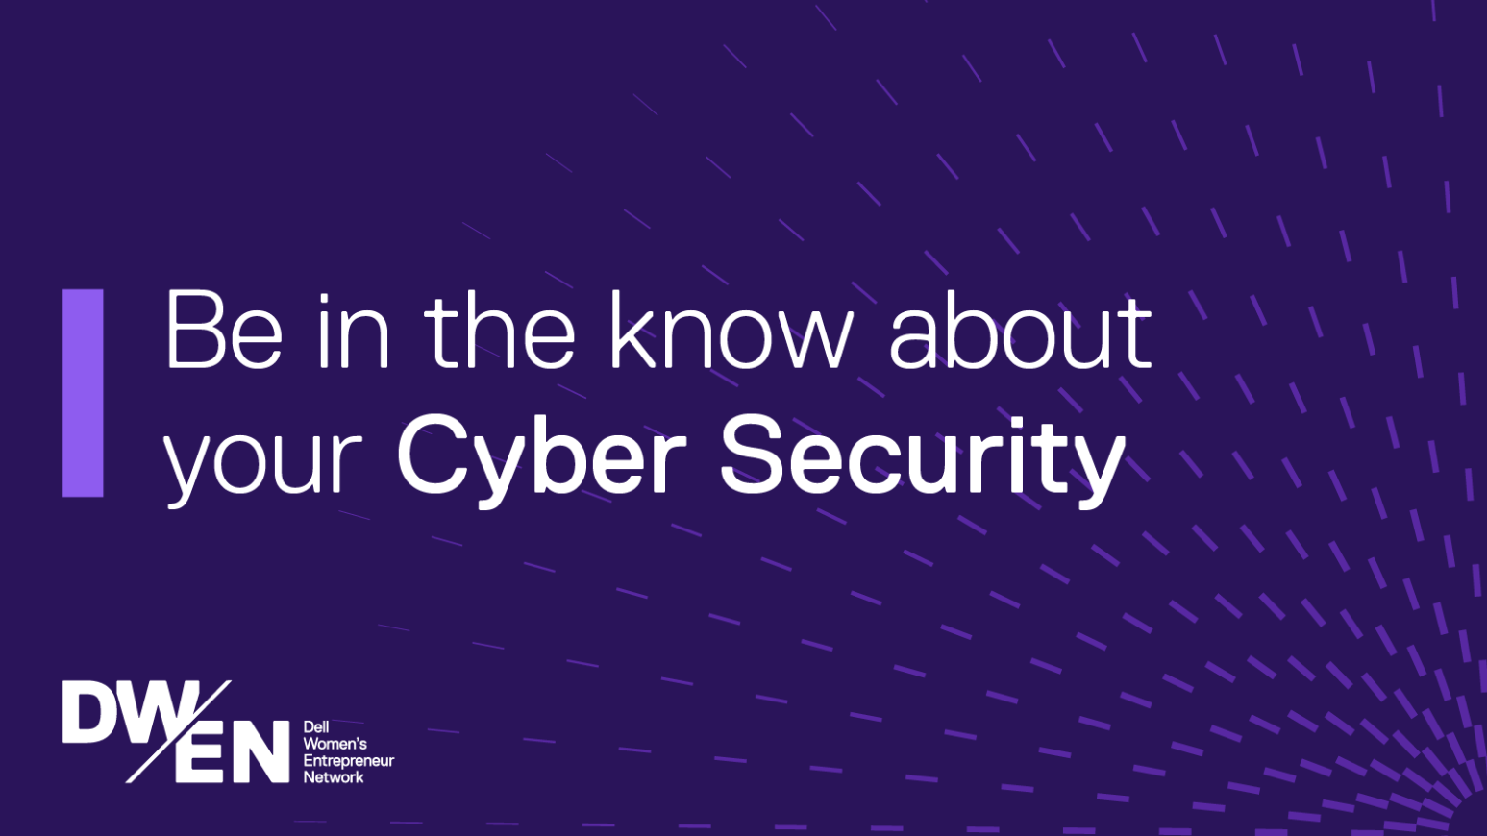
Technology Support Visit the “Tech Hub”
Listen to a recorded Tech Talk conversations
Read about AI, Tech Tips, Productivity, Security and more.
Learn tips and tricks with easy to navigate checklists.

Slide 20
Glance into the Tech Hub
Cybersecurity Reads
cyber security trends and risks for small businesses
Simple, cost-effective ways to upskill your team on cyber security
Checklist: How to build a cyber-secure culture on a budget
Releasing with our January Digest this week:
How to successfully roll out new technology in your startup
Checklist: A stress-free approach to implementing new technology
Coming February and March:
Want to attract talent to your startup? Celebrate innovation.
Simple, but powerful ways to make your startup more innovative
Checklist: Empower your employees to innovate
Why startups need to prioritize Generative AI to drive long-term growth.
How to use Generative AI to drive innovative thinking and gain a competitive edge
Creating a targeted Generative AI strategy
New articles and checklist launching every month.

Slide 21
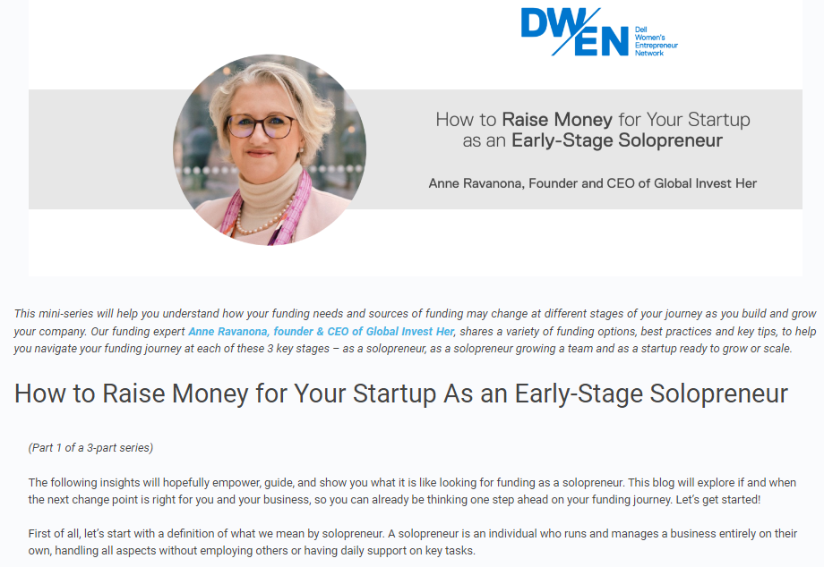
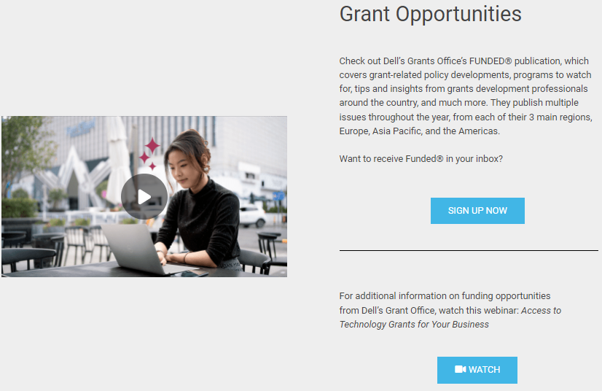
Funding Support Visit the “Funding Hub”
Resources for those seeking to navigating the funding landscape.
Participate in the Investor Masterclass to help you get investor ready.
Listen to “Funding Talks” focused on where to look for funding and what investors want.
Join the Funding Directory to be searchable by investors.
Apply for grants through the Dell Grants Office

Slide 22
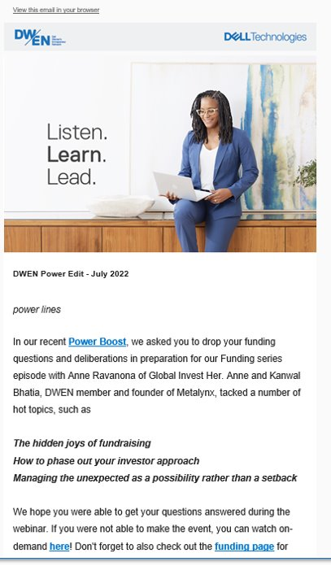
Email Communications
Be in the known about all things DWEN including new resources, events and spotlights. Watch you email inbox and bookmark DWEN.com for easy access.
Ongoing Communications
DWEN Digest (monthly newsletter)
Event Notifications (including Empower Hour, Tech Talks, networking events, etc.)
New Research (including WE Cities Index)
Contests and Rewards (Dream Tech contest, Dell Rewards, DWEN deals
Opportunities to share feedback (post event feedback, programming input, etc.)

Slide 23
Support and Advice
DWEN’s community is here to help you thrive. Get the support you need.
Access a Dell Technologies Advisor who can help you find the right solutions for your business to
Gain your competitive edge.
Get expert advice
Build a plan that makes sense for your vision.
Easy to request contact via form on DWEN.com
No cost to you
The Dell Grants Support Program offers their expertise and shares visibility into available funding for technology.

Slide 24
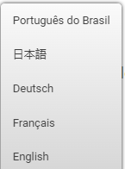
Global Community
DWEN supports select programming as localized content.
Additional translations will become available as the year progresses.
Members may select their preferred language on DWEN.com

Slide 25
DWEN.com Overview

Slide 26
DWEN.com Walk Through

Slide 27
Get Started
Update your profile including your picture and preferences
Join a Special Interest Group (SIG) or Chapter
RSVP for an event
Bookmark DWEN.com
View the blog and video library for relevant content
Watch your email and follow @DellTech on social media (Instagram, Twitter and LinkedIn) to stay up-to-date.

Slide 28
Guidelines for Engagement
No Pitching or Selling: Share, express and exchange ideas. Discuss thoughts and concepts. Refrain from pitching your project or company on public groups, forums, etc. to close sales or funding. (Unless of course asked or in a one-on-one conversation or private message)
The Member Marketplace is a great way to promote your skills and services.
Be Nice: All opinions and thoughts matter, please encourage each other through positivity and respect all members. All participants must conduct themselves within the bounds of professionalism, courtesy and respect. While disagreements and differences of opinion are encouraged, no one may engage in personal attacks or criticism that has the effect of disparaging or insulting any individual. Inflammatory comments, taunting, and baiting are prohibited.
Be a Steward of the Community: If offensive language or imagery appears please notify the DWEN Team. The DWEN team and chapter/group leaders have the right to delete posts if they are not adhering to the rules of engagement.
Create a welcoming space: The following topics and subject matter are unacceptable, must not appear in messages on the discussion forum.
Discussions of price, fees, or reimbursement amounts, may create the risk of antitrust exposure. This includes salary for job postings.
Abusive, threatening, defamatory or libelous comments
Pornographic, obscene or sexual materials or references
Inappropriate comments or references with respect to race, gender, religion, sexual orientation or ethnic background
Religious solicitations
Profanity
Illegal or unethical practices

Slide 29
FAQ
How do I connect with other experts within the community?
What resources are available for funding?
Where can I learn about new technology to help me grow my business?
How can small business be more secure and protect their businesses?
How does being a member help entrepreneurs scale?
Where can I find help for creating my pitch to investors?
I’m just getting started, am I in the right place?
What is the best technology to utilize for my small business?

Slide 30
Q&A
Submit Your questions in the chat box

Slide 31
Thank you!

